Slide 1
Chapter Eight

Slide 2




Slide 3


Slide 4
You ____ two small eyes.
My sister _____ three pens.
Can I _____ a new bag?
A bird ____ two legs.
Our school _______ a library.
We _______ 37 chairs in our classroom.
My sister ________ a doll.
Everybody ______ two hands.
Girls ______ many skirts.
她是大一学生。
他有一个有钱的父亲。
她加入了学生会。
他参加了共产党。
她是他的妹妹。
他是她的老师。
她的工作是什么？
他是一名软件开发师。
他是做什么的？
她是一名志愿者。

Slide 5
Visual reading

Slide 6
Expensive Price Dentist: I'm sorry, madam, but I'll have to charge you twenty-five dollars for pulling your son's tooth. Mother: Twenty-five dollars! But I thought you only charged five dollars for an extraction. Dentist: I usually do. But your son yelled so loud, he scared four other patients out of the office.

Slide 7
Who's More Polite? A fat man and a skinny man were arguing about who was the more polite. The skinny man said he was more polite because he always tipped his hat to ladies. But the fat man knew he was more courteous because, whenever he got up and offered his seat, two ladies could sit down.

Slide 8
Can we have our teacher back？ Once a superintendent of schools was visiting a three-room school. One room was very noisy, so the man grabbed a tall boy who had been standing up talking. He took the boy into another room and stood him in the corner. Five minutes later, a smalll boy came out of the first room and said, "When can we have our teacher back?"

Slide 9
How much English can you speak?
"Your Honor, I want to bring to your attention how unfair it is for my client to be accused of theft. He arrived in New York City a week ago and barely knew his way around. What's more, he only speaks a few words of English."
The judge looked at the defendant and asked, "How much English can you speak?"
The defendant looked up and said, "Give me your wallet!"

Slide 10
A gentle reminder
Having been married a long time, my husband sometimes needs a gentle reminder of a special occasion. On the morning of our 35th anniversary, we were sitting at the breakfast table when I hinted, "Honey, do you realize that we've been sitting in these same two seats for exactly 35 years?" Putting down the newspaper, he looked straight at me and said, "So, you want to switch seats?"

Slide 11
Cover page封面 notice通知
Instruction指令 upload上传
Respective各自的 recognize认识，认清
Arrange安排 jargon行话，术语
Omit省略 clip剪辑，片段
Typically往往，通常 effective有效的
Flowchart流程图 draft草稿，草拟
Hard drive硬盘驱动器 normally通常
Consequence后果 progress进度
Length长度 factor因素
Imperative祈使的，命令的 shortcut捷径

Slide 12
How to write user guide
Step by step instructions typically use the second-person point of view (you, your, yours). Instructions are usually written in active voice and the imperative mood: address your audience directly.
Most instructions are written in the form of a numbered list so that users clearly recognize the sequence of the tasks.
Effective instructions often include visual elements (such as pictures, diagrams, and flowcharts) that illustrate and clarify the text.
Checklist for writing instructions:
1. Use short sentences and short paragraphs.
2. Arrange your points in logical order.
3. Make your statements specific.

Slide 13
4. Use the imperative mood.
5. Put the most important item at the beginning of a sentence.
6. Say one thing in each sentence.
7. Choose your words carefully. Avoid jargon and technical terms if you can.
8. Give an example or an analogy, if you think a statement may confuse a reader.
9. Check your completed draft for logic of presentation.
10. Do not omit steps or take shortcuts.

Slide 14
Recap and Practice

Slide 15
Interview
Reporting for Work
Office Talk
Describing job and company
Telephone English

Slide 16
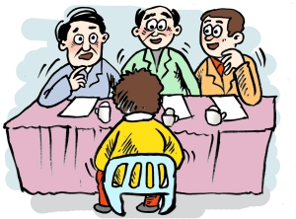
Interview

Slide 17
Introduction
Questions and answers

Slide 18

Reporting for Work

Slide 19
问前台办公室在哪
前台带到部门后，介绍新人
新人自我介绍
同事介绍新人给领导
新人与领导的对话

Slide 20
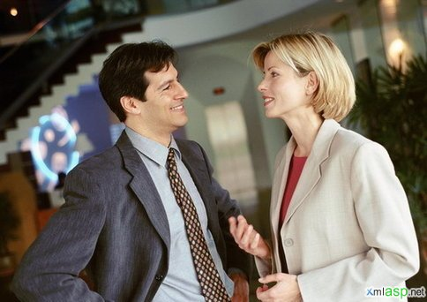
Office Talk

Slide 21
日常寒喧
寻求帮忙

Slide 22

Describing job and company

Slide 23
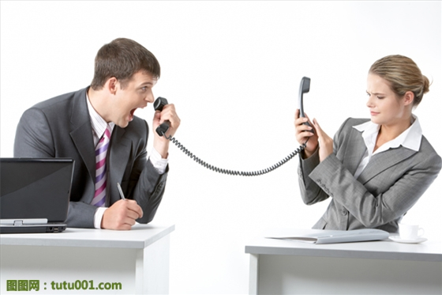
Telephone English

Slide 24
打电话
留言

Slide 25
Company Introduction
Background
Product
Staff
Department
Client
Competitor

Slide 26
What type of company is it? Can you tell me sth about your company? | Our company is…
What is your company’s main product? | Our leading product is…
How many employees do you have? How many staff do you have? | We have…
How many departments are there in your company? | It consists of …
How do your products differ? | We offer…
Do you have a large client base? | Our biggest clients include…
Who would you say is your biggest competitor? | That would have to be…

Slide 27
Our company was set up in 2009. It’s now one of the biggest manufacturers of oils, and we have offices in every major city. We have about 2300 staff in the plant and 500 in the office. This company consists of seven departments: Production, Purchasing, Finance, Auditing, Marketing and R&D. Our leading product is Peanut Oil. We deal in a wide range of related products. We now have 30% of the market. We will get more next year as our new production line is put into operation. Last year, our net profit was 10 million Yuan.

Slide 28
The Singapore Telecommunications Limited, commonly abbreviated as SingTel was established in 1879 and is Asia’s leading communications group. Our main operations are in Singapore and Australia. Headquartered in Singapore, SingTel has more than 130 years of operating experience and has played a pivotal role in the country’s development as a major communications hub.
We Chengdu branch is located in Tianfu Software Park of high tec zone since December, 2005. Now we have more than 700 staff with software developers reaching 97%. We provide a wide spectrum of multimedia and infocomms technology (ICT) solutions, including voice, data and video services over fixed and wireless platforms. It has a combined mobile subscriber base of 477 million customers from its own operations and regional associates in 25 countries, making it one of the largest mobile network operators in Singapore and the 20-30 largest in the world.
Today, we continue to lead and shape the local digital consumer market and ICT market. And we are committed to training professionals to serve our society and seek mutual development with our company and society.

Slide 29
Courtesy in Writing
You ought to send us documents before Friday .
Your letter is not clear at all.
I can't understand it.
Obviously, if you'd read our policy carefully, You'd be able to answer these questions yourself.

Slide 30
1. 把命令变成请求的常用形式
Will you……..?
Will you please……..?
E.g.： a) Will you give us more detailed information on your requirement?
b) Will you please (kindly) let us hear from you on these two points?

Slide 31
2. 虚拟式（Past Subjunctive From）
1. Would you compare our sample with the goods of other firms? 2. We wish you would let us have your reply soon. 3. This would seem to confirm our opinion.
4. We might be of some service to you in a similar case. 5. We think if advisable that you should accept this offer at this price.

Slide 32
请让我们知道具体的数量
We should(would) like you to let us know the exact amount.
请看一下实际的商品
Perhaps you might like to have a look at the actual goods.
如能给予我们一些建议，将不胜感激
We should be grateful if you would help us with your suggestion.

Slide 33
3. 缓和用法（Mitigation）
缓和过分强调或刺激对方，常用:
We are afraid
we would say
we may(or, might) say
we(would) think
it seems(or would seem) to us
we(would) suggest
as you are (or: may be) aware
as we need hardly point out

Slide 34
(a) It was unwise of you to have done that.
We would say that it was unwise of you to have done that. (b) You ought to have done it.
It seems to us that you ought to have done it. (c) We cannot comply with your request.
We are afraid we cannot comply with your request. (d) Our products are the very best on the market.
We might say that our products are the very best on the market.
(e) You must keep the matter to yourselves.
You must, we would add, keep the matter to yourselves. (f) You must cut off your order in half.
We would suggest that you cut your order in half. (g) We have not yet had your reply.
It appears that we have not yet had your reply.

Slide 35
4. 运用被动语气
a) You made a very careless mistake.
A very careless mistake was made
b) You did not enclose the check with your order.
The check was not enclosed with your order.
c) For the past two years, you did not give us any order.
For the past two years, no order has been given to us.
For the past two years, no business has been materialized between us.

Slide 36
5. 避免（或力争避免）使用语气强烈或容易引起不快的词汇
we demand immediate payment from you
We request your immediate payment.
b) We are disgusted with your manner of doing business.
We are not completely satisfied with your manner of doing business.
c) We must refuse your offer.
We regret that we are unable to accept your offer.
Or: We regret that we are not in a position to accept your offer. d) We want you to assist us.
Your assistance would be appreciated.

Slide 37
要分清"礼貌"与"卑恭"的界限
e.g.：(a) We are extremely and sincerely sorry for the error and ask that you accept our humble and sincere apology for the undue inconvenience suffered by you.
(b) We beg to acknowledge receipt of your letter dated 11th December.
(c) We beg to enclose herewith our invoice.
可改为:（a) We are concerned about the inconvenience you have suffered, and apologize sincerely.
（b) We have received your letter of Dec. 11.
（c) We enclose(herewith) our Invoice.
Or: We are pleased to enclose our invoice .

Slide 38
Practice

Slide 39
Luisa, thanks for your email about the new brochure and the attached file with the quote from the printers. It is very expensive. Isn’t it a better idea to contact some other printing firms and get some alternative quotes? After all, we have been very unhappy with the quality of their work on the last few jobs. What do you think?
It seems / I think it’s quite / a bit / a little / rather expensive.
Wouldn’t it be a better idea…
We haven’t been very happy…

Slide 40
Frank, sorry we didn’t have a chance to talk yesterday. Actually, I have a favour to ask. I wonder if you can have a word with Sandra in Human Resources about when the position of Sales Director is going to be advertised. It’s delicate for me, as I’m sure you understand, because there is a chance I will be one of the candidates. Thanks.
Actually, I have small favour to ask.
I was wondering if you could …
It’s a bit delicate for me.
I might / may be one of the candidates.

Slide 41
Steven, thanks for sending the suggestions on how to price our new range of accessories. I don’t agree with you. The prices you suggest are too high for the market. Don’t you think a lower price will result in higher sales and therefore higher profits? Let me know what you think.
To be honest, I’m not sure I agree with you.
The prices you suggest seem to be / might be quite / a bit / a little / too high for the market.
Don’t you think a lower price would result in ….

